Slide 1
RepQuest Status Update
Dylan Hulon, Austin Jones, Benjamin Johnson, Jaylen Cook

Slide 2
We are RepQuest!!
We will be discussing the current status update of RepQuest.
We will be discussing:
  Quick Refresher
  What Has Been Worked On
  Whats Next!
  The Workload Plan
  Block Diagram
  Entity-Relationship Diagram (ERD)
  Component Diagram

Slide 3
Quick Refresh(update this)
RepQuest is an Android Fitness App
RepQuest will allow the user create and save custom workout templates.
User will be able to upload and track workout history, stats, and goals.
Customize a personal avatar with unlockable items.
Earn rewards through achievements and progress.
Combines fitness with a gamified motivation!

Slide 4
NavBar

Slide 5
NavBar (Completed)
The navigation bar itself is completed.
  Settings Menu
    Drop down menu for the default unit of time implemented
    Drop down menu for the default unit of distance implemented
    Toggle for vibrations implemented
    Toggle for Chimes implemented
    UI buttons to upload or download data from server implemented
  Workout Menu
    RepQuest Title implemented
    Create Exercise Button created but has no implementation

Slide 6
NavBar (In progress)
These components are still in their development phase, and are soon to be implemented.
User Interfaces
  Navigation Bar Components
    Goals
    History
    Workout
    Statistics
There are placeholders for them at the moment, however, their functionality is not yet complete, but is in development.

Slide 7
Database

Slide 8
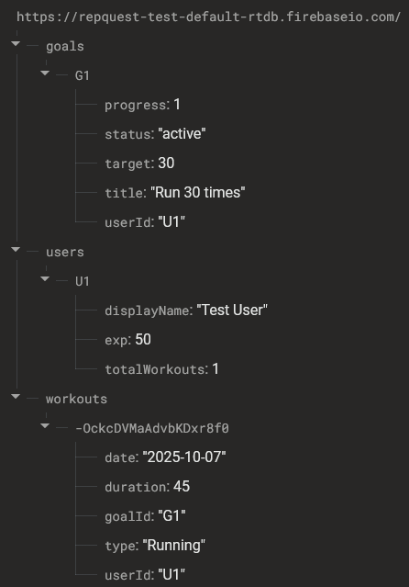
Database Tester
This tester has been constructed to demonstrate core database operations
This is only for testing purposes, to help refine the final database layout and structure
Database development has not deviated from the original proposal

Slide 9
Next to be Implemented

Slide 10
What’s Next
Test Data Set
  Create a test data to be able to test many components of the program before the creation aspect is made
    This will allow us to test many portions of our app without having to create a workout template each time
    This will also allow us to see what kind of data we’ll be dealing with and what we should and shouldn’t let the user be able to input
History Screen
  Create the UI for the history screen
    Being able to display the history of our stored data is one of the highest hurdles of creating our app. Tackling this hurdle early will allow us to determine whether we should keep this idea or modify it to make it easier to produce

Slide 11
Roadmap

Slide 12
Not Implemented yet
Gamification Layer
  Avatar Sprites
  Item Sprites
  Experience Points Redemption
Workout Page UI and Functionality
Create a Workout UI and Functionality
Exercise Screen UI and Functionality
Stats UI and Functionality
Goals UI and Functionality
History UI and Functionality
Confirmation Dialogue Boxes

Slide 13
Plan of Attack
Group 1
Testing Dataset
Exercise Screen
Gamification Layer
  Customize Avatar Screen
    Avatar Sprites
    Item Sprites
  XP/Level System
    Confirmation Boxes
Group 2
History UI and Calendar
Exercise Screen
Create A Workout Screen
Create an Exercise Screen
Stats Screen
Goals Screen

Slide 14
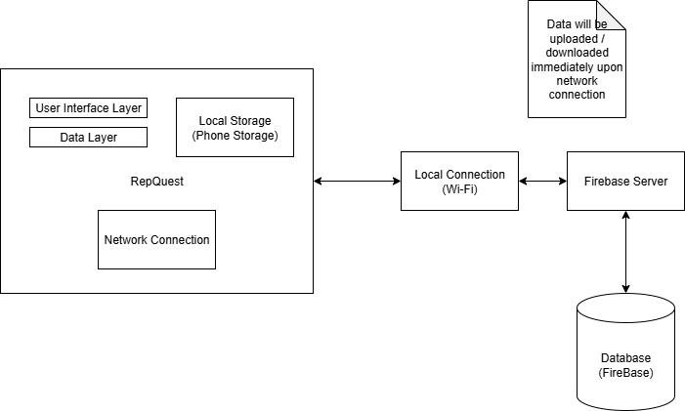
Block Diagram

Slide 15
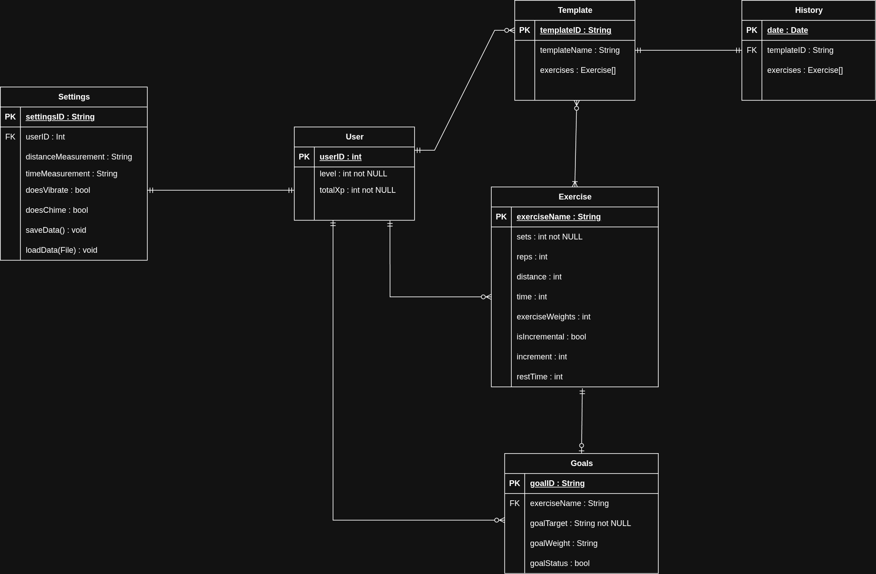
Entity-Relationship Diagram

Slide 16
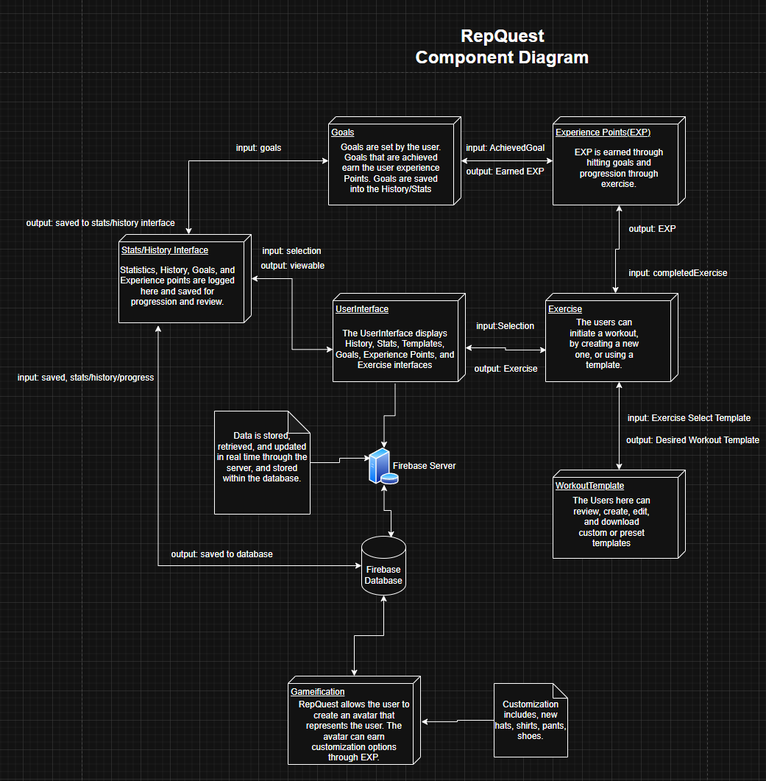
Component Diagram

Slide 17
Summary
Navigation bar and Settings Interface is Completed.
Database tester has been created.
Core UI Sections are in development.
Next Focus :
  Completion of the Core UI
  Calendar
  Testing data
  Gamification layer

Slide 18
Thank you all for your time!
-RepQuest

